Slide 1
Cooperative and Adversarial Multi-Agent Reinforcement Learning
Sean Osier, Emily Ye, Danny Zhang, Yutong Zhou
Notes:
Sean

Slide 2

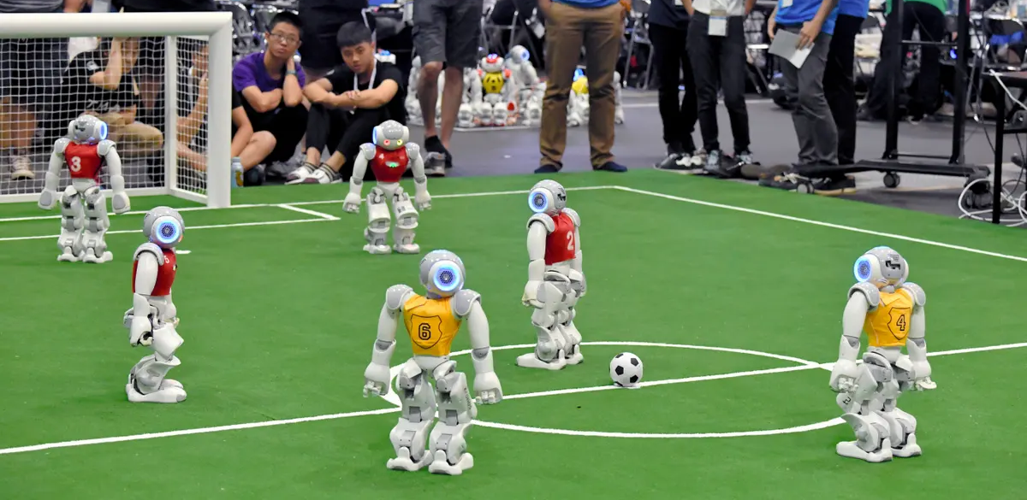
Project Motivation
The algorithms we studied in class were all single-agent focused
We were curious about reinforcement learning in multi-agent settings, particularly ones were there are mixes of agent groups (e.g., a team and an opposing team) that required aspects of both cooperation and competition
Notes:
Sean

Slide 3
Background: Multi-Agent Reinforcement Learning (MARL)
Type of MARL environments:
Agent Relationship: Cooperative vs. Adversarial vs. Mixed
Learning Style: Decentralized vs. Centralized
Degree of Shared Knowledge / Communication
While there does not appear to be a singular standard for best MARL algorithms or approaches, popular ones include:
MAPPO (Multiagent-PPO)
Self-play
Curriculum learning
Notes:
Sean

Slide 4
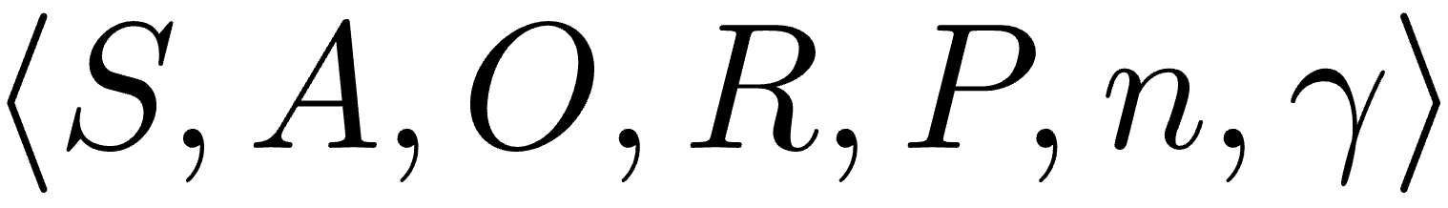
Background: DEC-POMDPs
DEC-POMDPs = Decentralized Partially Observable Markov Decision Process
Formally defined by:
S = Global state space
A = Shared action space
O(s, i) = o_{i} = Local observation for agent i, at global state s
R = Reward function
P = Transition probabilities given state and joint action (a₁, …, a_{n})
n = Number of agents
𝛾 = Discount factor
Decentralized = Each agent keeps its own experience buffer (as opposed to have a shared buffer)
Major drawback: Markov process is NOT stationary, so no guarantee of convergence
Notes:
Sean

Slide 5
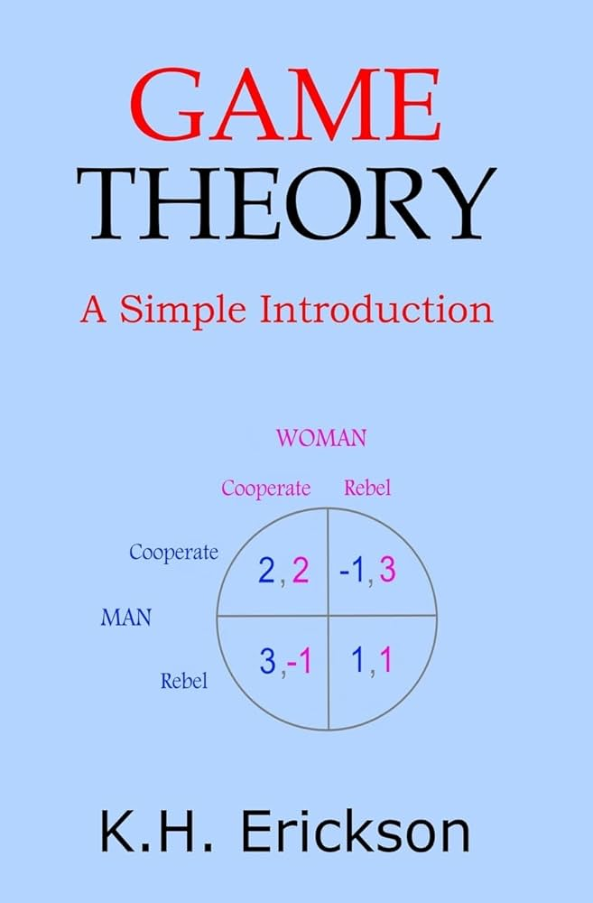
Background: Game Theory 101 / Nash Equilibrium
Game Theory: The study of mathematical models of strategic interactions among rational agents
As such, very relevant to multiagent reinforcement learning
Nash Equilibrium: A situation where no agent can gain by changing their own strategy (holding all other agents’ strategies fixed)
The “solution” to a game theoretic problem
Stable solution, but importantly may NOT be globally optimal for the individual agents
Nash proved a Nash equilibrium exists for every finite game
As such, we should expect our experiments to converge to Nash equilibria (if they converge)
Prisoner’s Dilemma: The most famous, simple example
Nash Equilibrium (NOT globally optimal)
Notes:
Sean

Slide 6
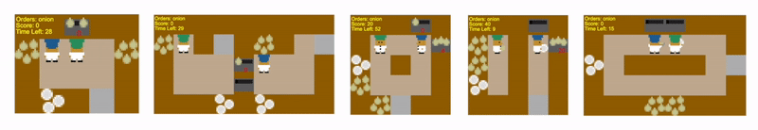
Our Environment: Overcooked → Simple Spread
The Overcooked environment we intended to use was not maintained
Caused large range of dependency errors between the original Overcooked library, derivative libraries, and other utility libraries
Debugging and fixing the issues would have occupied a significant amount of our time
Since our focus was on experimenting with multi-agent reinforcement learning and not on building environments for multiple agents, we decided it was best to pivot to a widely used and frequently updated/maintained library such as pettingzoo, specifically the Simple Spread environment
Notes:
Emily

Slide 7
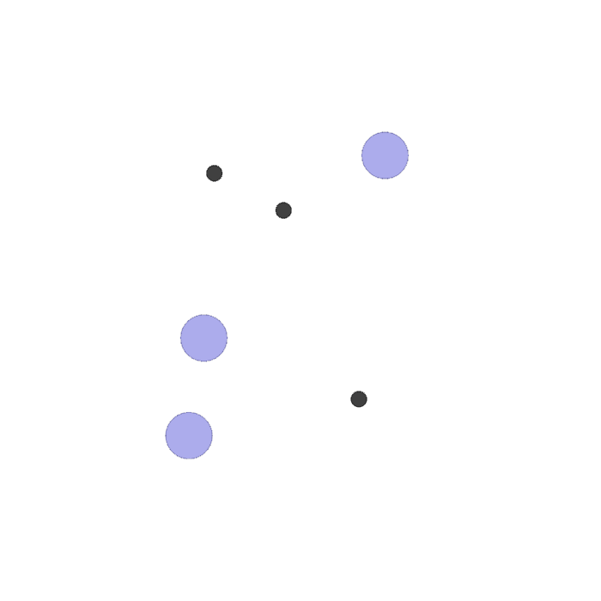
Our Environment: About Simple Spread
This environment has N agents, N landmarks (default N=3)
Agents are globally rewarded based on how far the closest agent is to each landmark (sum of the minimum distances)
Locally, the agents are penalized if they collide with other agents (-1 for each collision)
Agent observes its own position / velocity, as well as the relative position of the other agents and landmarks
Possible actions are move up, left, right, down, and no action
Notes:
Emily

Slide 8
Experimental Approach and Setup
Goal: To study multi-agent behavior in cooperative, adversarial, and mixed-play settings, we aimed to examine agent performance under the following lenses: number of agents, amount of communication, and information transparency between adversarial and cooperative agents
DQN (for cooperative, adversarial, mixed environments): Same as studied in class, but one DQN per agent
(Really 2 per agent if you count the target network)
MA-PPO (for adversarial environments): Adapted an MA-PPO library to work with our modified Simple Spread environment.
PPO (Schulman et al., 2017) is an on-policy algorithm that restricts magnitude of policy updates
We use a “clipped”, decentralized variant of PPO
Notes:
Emily

Slide 9
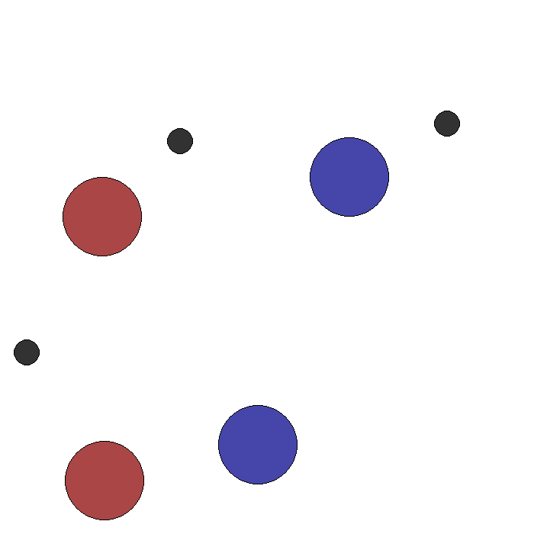
Environment: Modifying to Support Adversaries
Simple Spread by default is only cooperative
While other adversarial environments were available, we thought it was important to be able to compare agents across environments with with the same reward structure
Key changes:
Adding adversaries
Supporting different number of landmarks and agents
Adversarial agent scoring:
+1 for collisions with “good agents”
-1 for collisions with other adversaries
Notes:
Sean

Slide 10
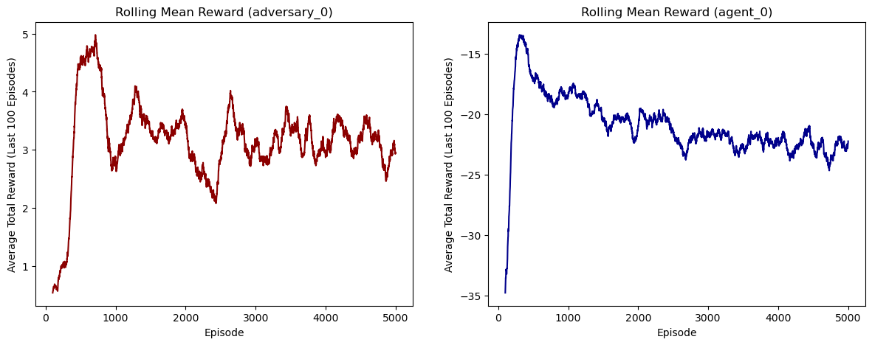
Adversarial Training: Example w/ 1 adv., 1 agent, 1 landmark
In adversarial environments, it’s hard to know if your agents have “solved” the environment:
During training, we should expect all agents get better at the start as they learn the basics of the environment
BUT, after that we should expect to see performance worsen because their competition is getting stronger also
Ultimately we should expect the agents to converge to a Nash equilibrium (if they converge)
B) Competition Stiffens
C) Nash Equilibrium? (Training rewards leveling off for both)
A) Learning the Basics
Example shown above is of the DQN agents during training. PPO follows a similar trend.
Notes:
Sean

Slide 11
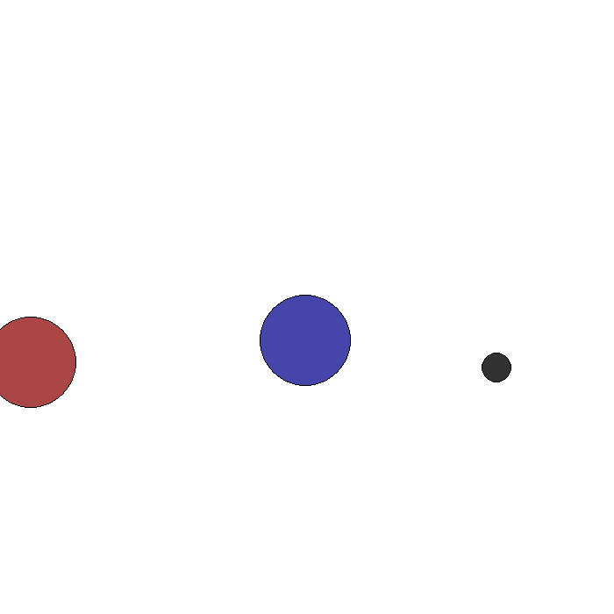
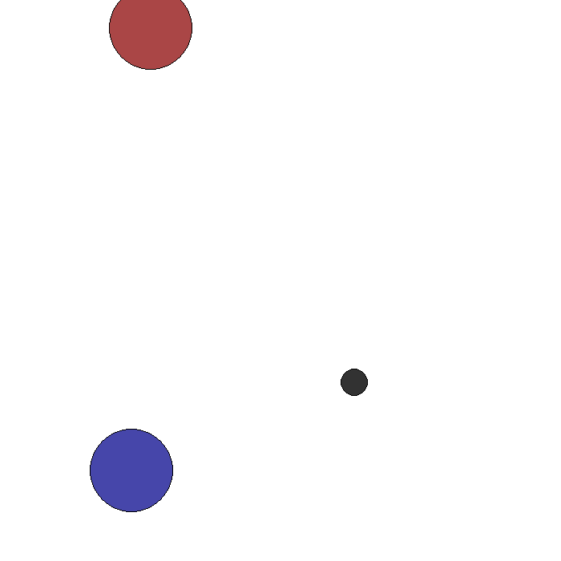
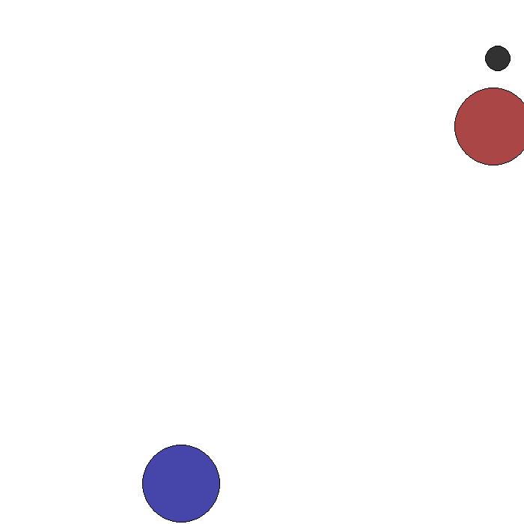
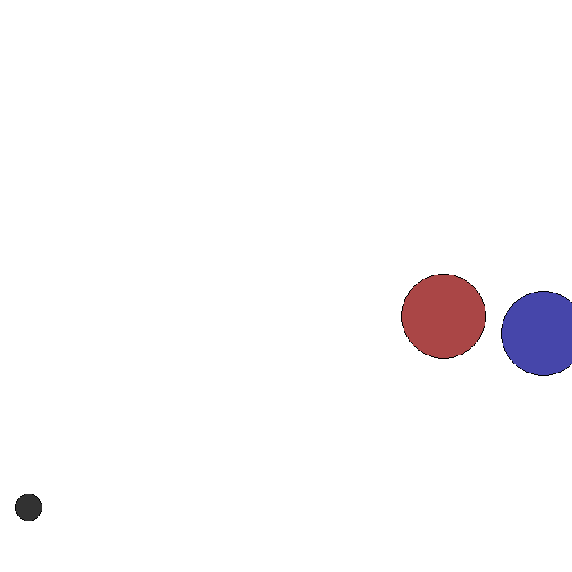
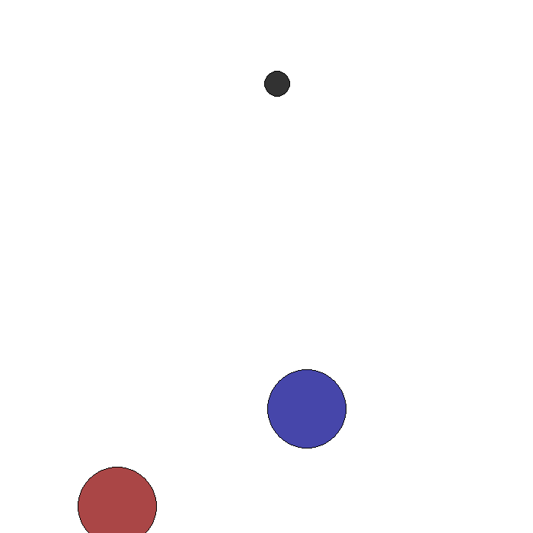
Adversarial Test Results: Example 1 adv., 1 agent, 1 landmark
Qualitatively, we observe that our agents have learned sophisticated behaviors:
Precise movement skills, including varying speeds where appropriate
First and even second order anticipation (what you might call planning)
An ability to leverage the physics of the environment to their advantage
Notes:
Sean

Slide 12
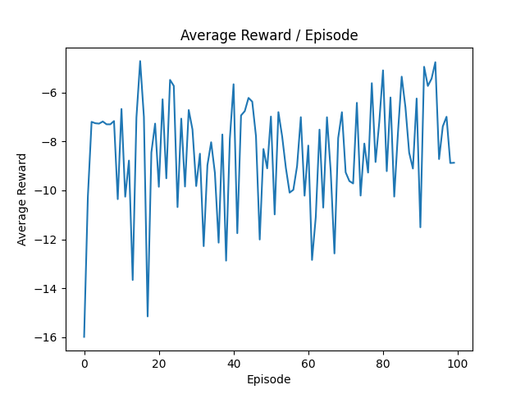
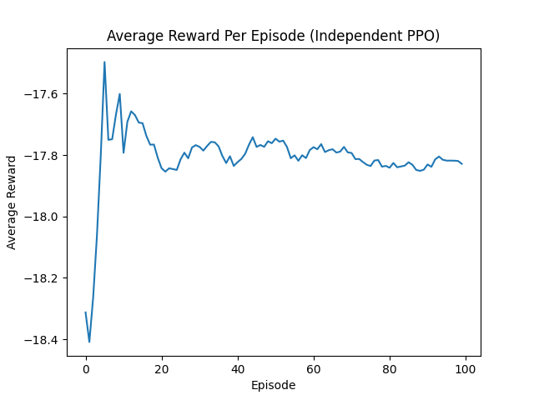
Adversarial Test Results: Example 1 adv., 1 agent, 1 landmark
This is what we observe in our DQN and PPO gameplay after training:
Reward levels are roughly comparable (depending on the run, PPO slightly outperforms DQN or vice-versa. Below is an example where DQN slightly outperforms PPO)
PPO always appears to be more stable.
DQN
PPO
Notes:
Emily

Slide 13
Scaling Beyond 1v1 Adversarial Gameplay
We tested various kinds of scenarios with larger numbers of agents, adversaries, and landmarks:
E.g., adversaries are “outnumbered” and/or at disadvantage (2 adv, 4 agents, 4 landmarks, 2 adv., 4 agents, 8 landmarks)
Across all runs for both DQN and PPO, average adversary rewards tended to hover in the low positive/negative single-digits while agent rewards were more strongly negative, particularly (and understandably) as the number of agents and adversaries increased
Depending on the run, as well as the scenario, DQN sometimes performs better than PPO and vice-versa (though PPO was always more “stable” with its average rewards).
Notes:
Emily

Slide 14
Environment: Modifying for Communication Modes
In addition to modifying the source code to add adversaries, we also modified the amount of information between agents by adding a variety of communication modes
Key changes:
Added following communication modes for what information individual agents can receive:
Mode 0: Information on other agent positions is masked
Mode 1 (Baseline for information): Information on the location of other agents and landmarks is provided
Mode 2: Additional information on other agent velocity
Mode 3: Additional information on other agent’s Euclidian distance to all landmarks
Mode 4: Similar to Mode 3, but now each other agent provides a binary variable if they are within .5 distance to any landmark
Mode 5: Appends the information from mode 2 and 3 to the baseline
Notes:
Danny

Slide 15
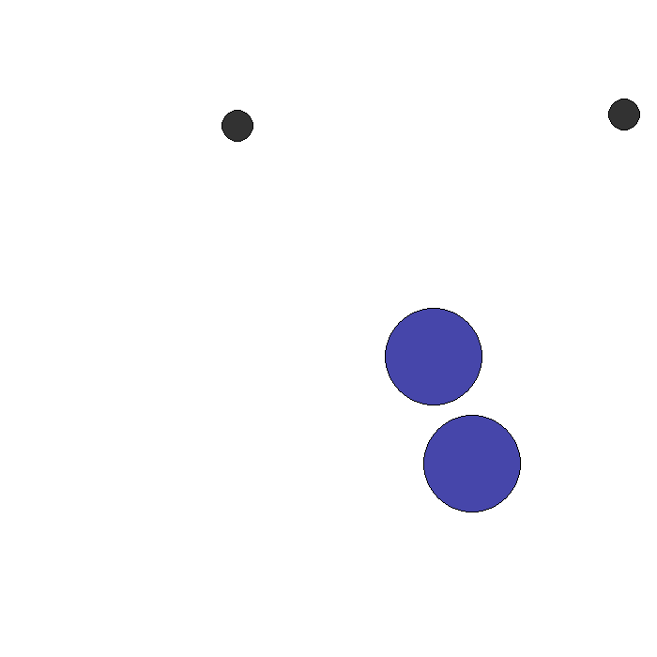
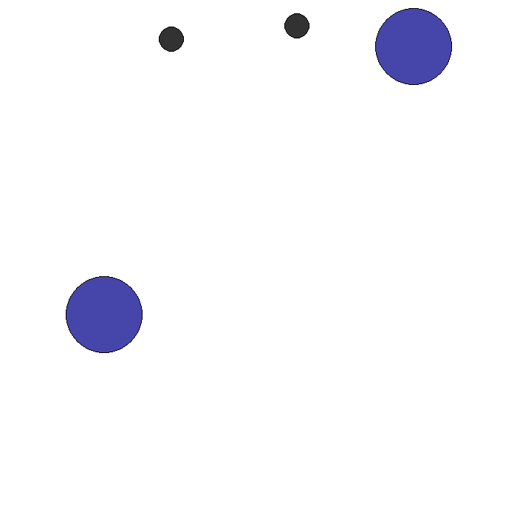
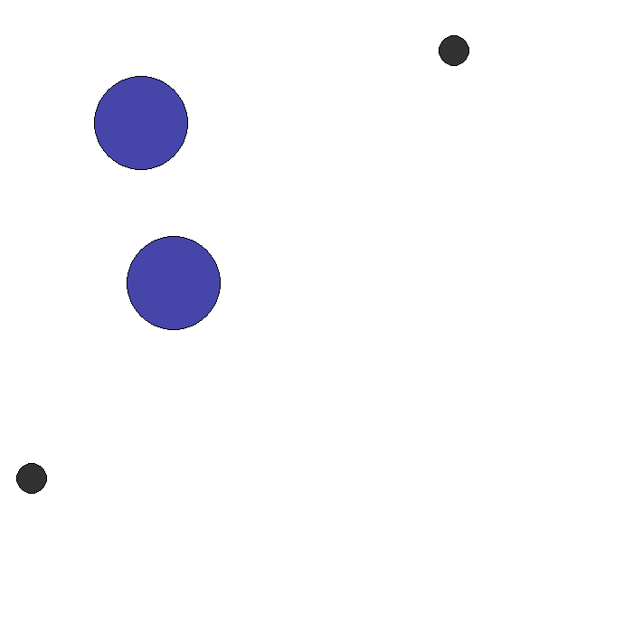
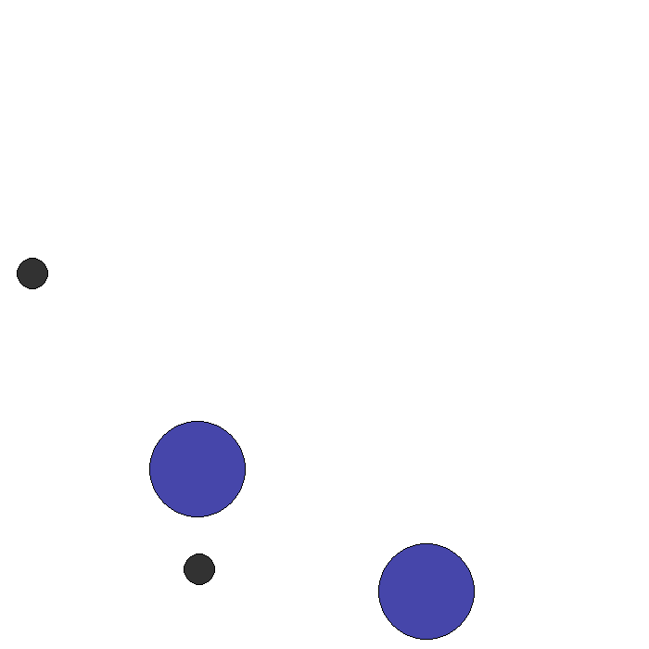
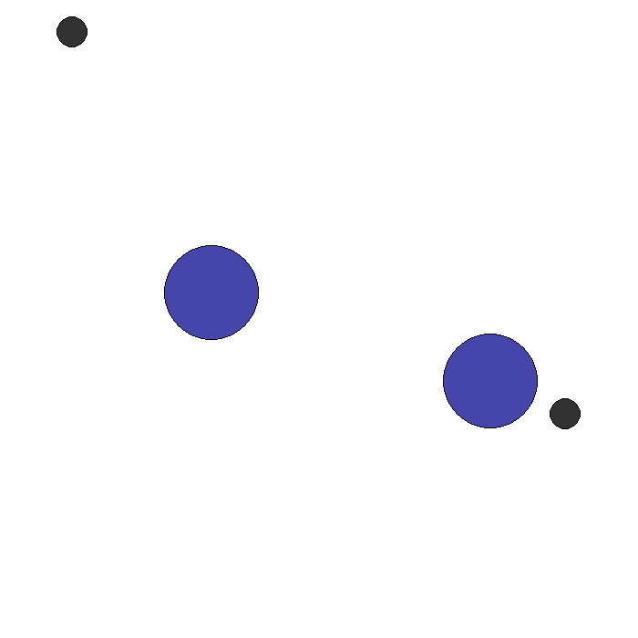
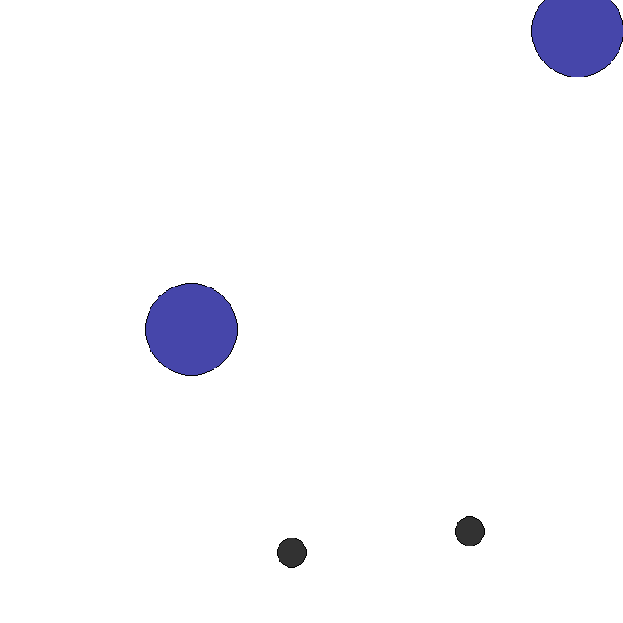
Communication Results: 2 agents, 2 landmarks(1/2)
Qualitative results
Counterintuitively, passing more information about other agents in the environment does not always yield improved results
Information regarding other agents’ positions/velocities appears to yield best mean rolling rewards. These rewards are decreased when other agents’ Euclidean distances are also included in communication
Mode 0
Mode 1
Mode 2
Mode 3
Mode 4
Mode 5
Notes:
Danny

Slide 16
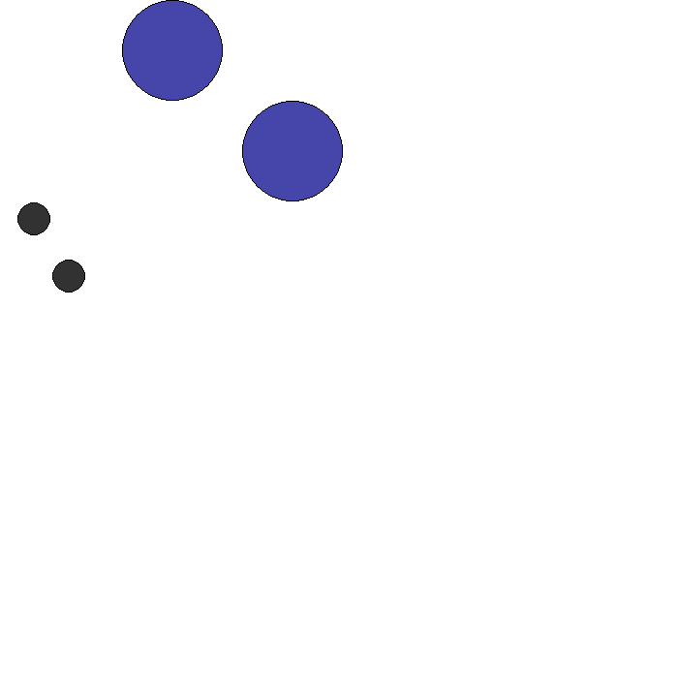
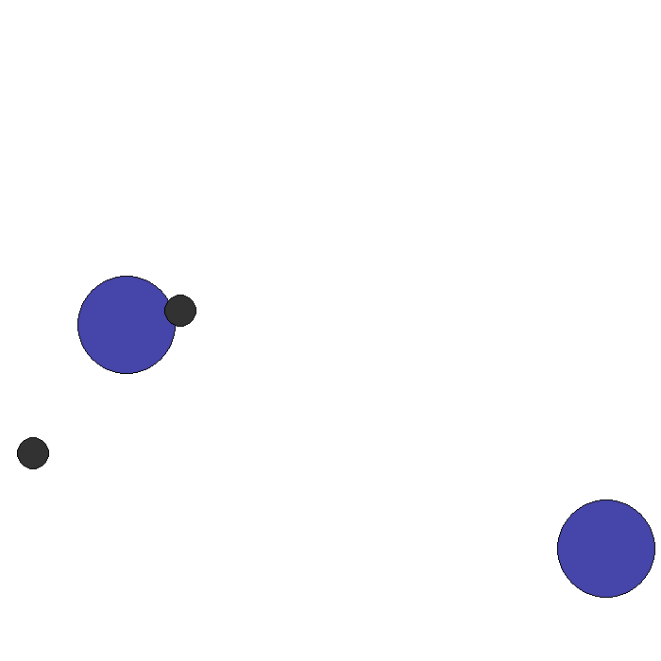
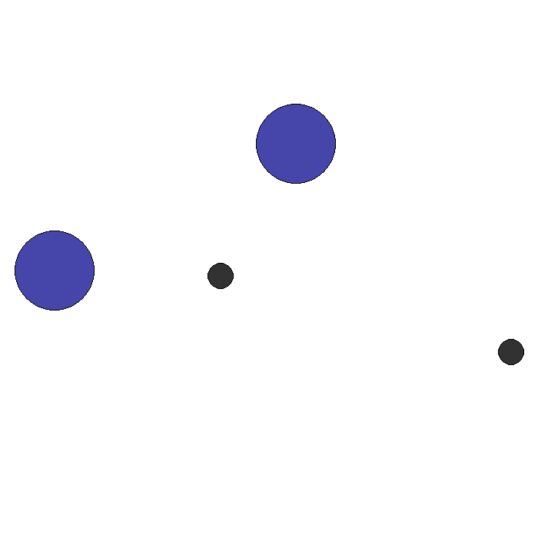
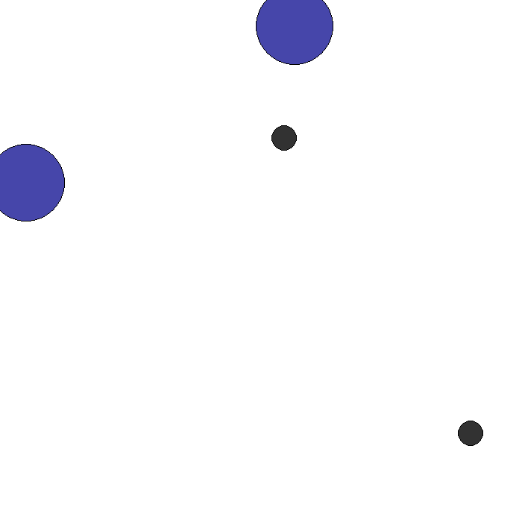
Communication Results: 2 agents, 2 landmarks(2/2)
Gameplay patterns
With no communication between agents, agents will often reach landmarks quickly but can sometimes incur a large penalty for repeated collisions
With communication added, agents are much more likely to be able to adjust the travel trajectory to avoid collisions
In rare cases, agents use bumping as a method to increase velocity towards landmarks
Notes:
Danny

Slide 17
Combining Adversarial and Communication Experiments
We incorporate the communication parameter we use for our cooperative communication experiments into our adversarial agents and non-adversarial agents
We would like to observe the effects of different levels of communication in a competitive environment
We begin by examining results under a transparent information passing setting
The adversary receives a communication vector with the same parameters from cooperative agents, and vice versa
Notes:
Miranda:
We’ve examined agent performance under cooperative and adversarial conditions so far, as well as cooperative agents’ performance when communicating different pieces of information to each other. Now, we would like to see the effects of these modifications when combined. We elected to experiment using the DQN algorithm as we found that was what was most stable overall.
Using the same logic used for our cooperative agents’ communication, we incorporate the same communication vector and modes into the adversarial agent class. To begin with, we assume that all agents are communicating with each other: adversarial with cooperatives and vice versa. This would intuitively not be the case in a competitive setting, but we will show the effects of limiting communication to only agents of the same type later. We call this setting of communication among all agents an information transparent setting.

Slide 18
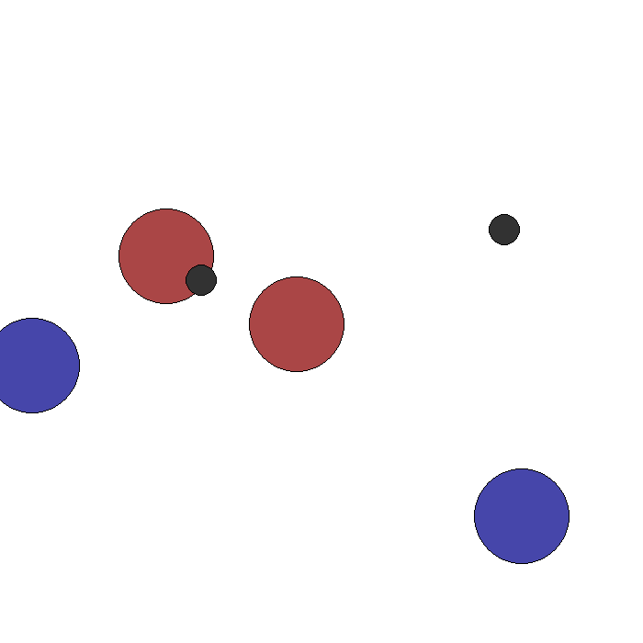
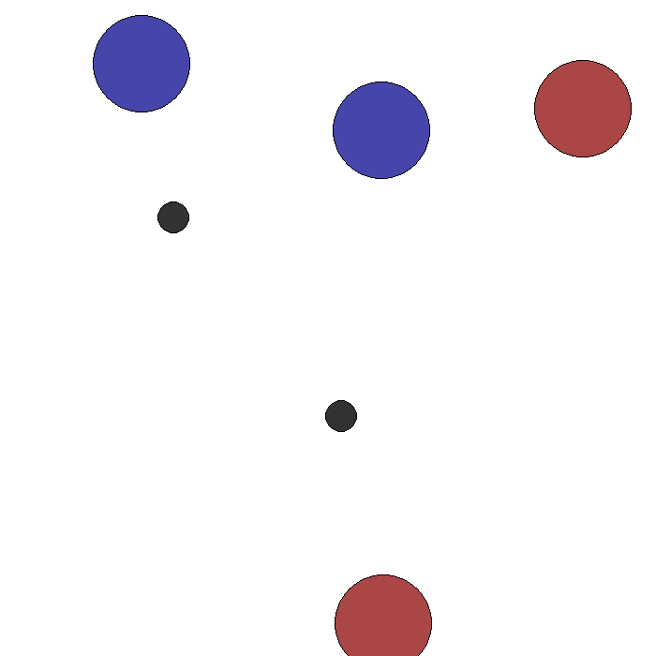
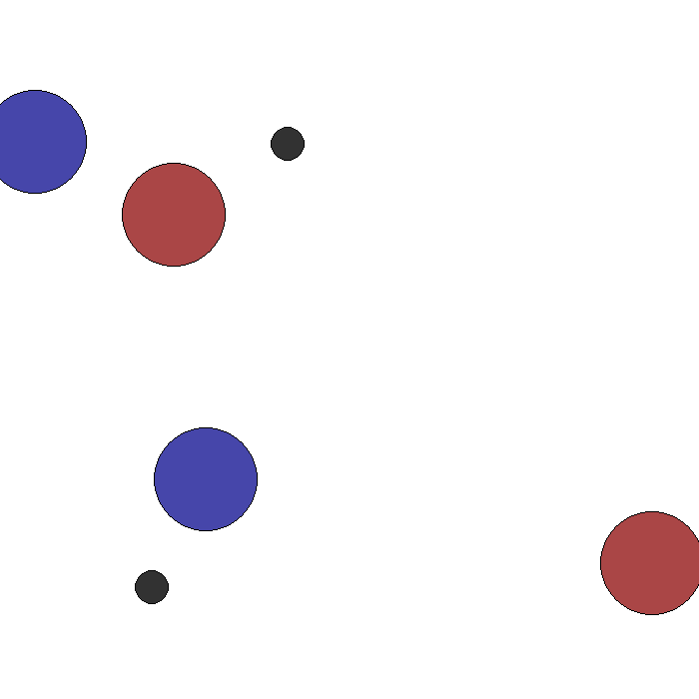
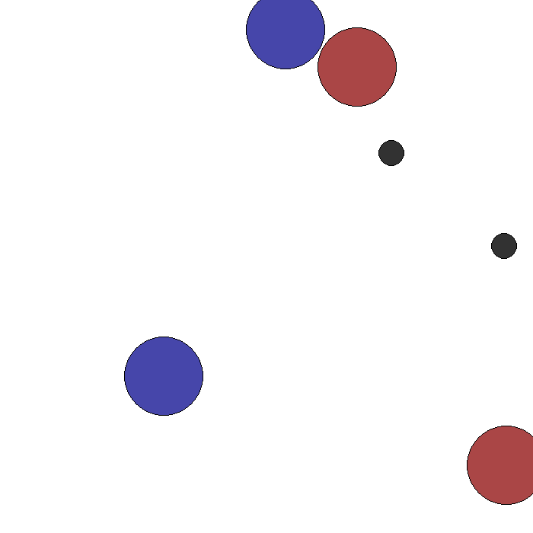
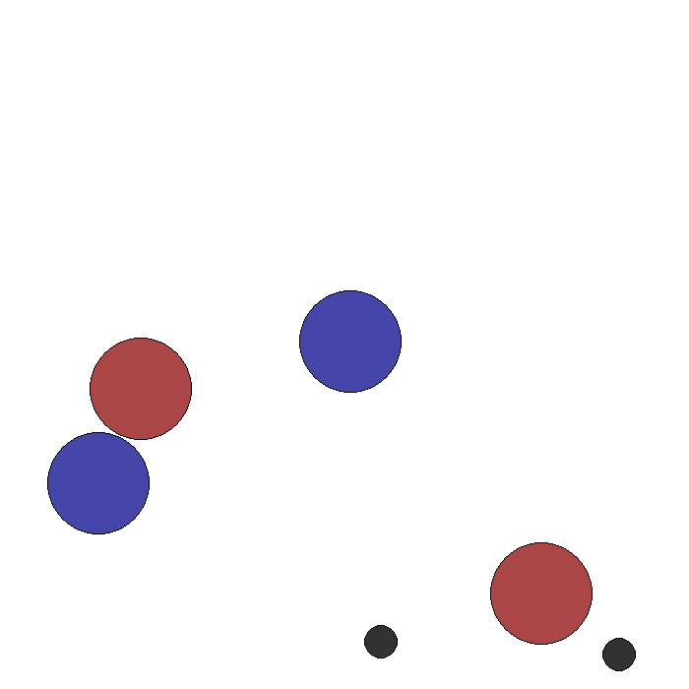
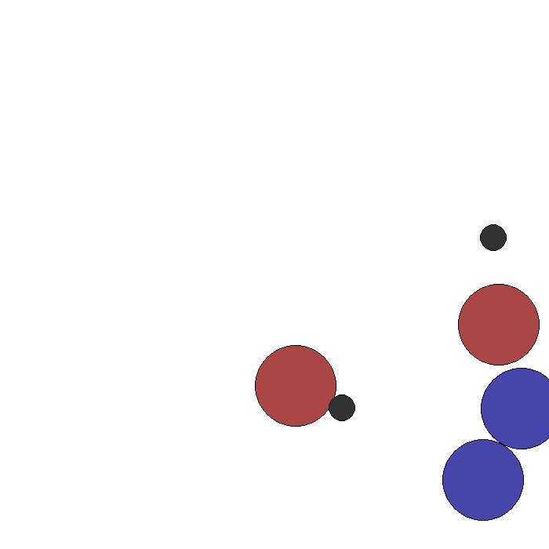
Adversarial Communication Results: 2 adversaries, 2 agents, 2 landmarks, information transparency
Qualitative results
Lack of success for non-adversarial agents in reaching goal landmarks, which can likely be attributed to the adversaries receiving communication regarding their positions
Significant number of instances where the adversaries will “sit” on top of the landmarks to prevent non-adversaries from reaching their goals
Mode 0
Mode 1
Mode 2
Mode 3
Mode 4
Mode 5
Notes:
Miranda:
We begin with the following: a setting with 2 adversaries, 2 non-adversarial agents, 2 landmarks, in our “information transparent” setting.
Qualitatively, we see some interesting behaviors from agents in a competitive setting when they communicate to each other. We see, generally, a lack of success from non-adversarial agents in accomplishing their goals of both reaching the landmarks. This is intuitive, as the adversaries know the non-adversarials’ positions, and can coordinate and respond accordingly. We actually see multiple instances of adversaries “sitting”” upon the goal landmarks to prevent the non-adversaries from accomplishing their goal.
Especially for the modes where the agents’ positions or velocities are communicated, we see significant evidence of adversarial agents’ cooperating to each go after non-adversarial agents’ separately. It is intuitive that the non-adversarial agents are penalized in terms of rewards in this setting, as the adversarial agents receive information regarding those agents’ locations as well as the position of the end goal landmarks.

Slide 19
Adversarial and Communication Experiments: No Information Transparency
Logically, adversaries would not communicate to non-adversaries, and vice versa
We devise the adversarial communication experiments under an information non-transparent setting, where adversaries communicate with adversaries and “regular” agents communicate amongst themselves
When compared to the information transparent setting, we observe the following:
Decreased rolling mean rewards for adversaries
Increased rolling mean rewards for non-adversaries
Notes:
Miranda:
As mentioned, logically, in the real world, agents in competition with each other would not communicate with their competitors. Therefore, we devise an “information non-transparent” setting, where adversaries only communicate with other adversaries, and vice versa for non-adversarial agents. Very intuitively, we quantitatively observe improved rewards for non-adversaries, and decreased rewards for adversaries, when we compare to the information transparent setting.

Slide 20
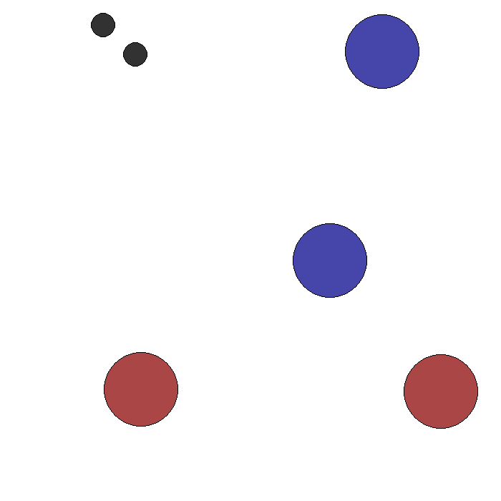
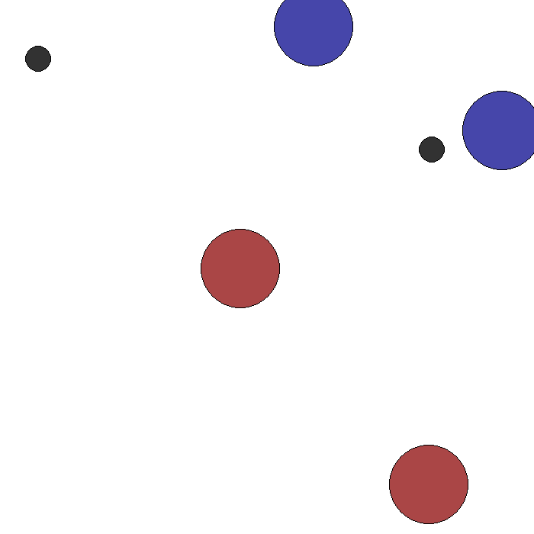
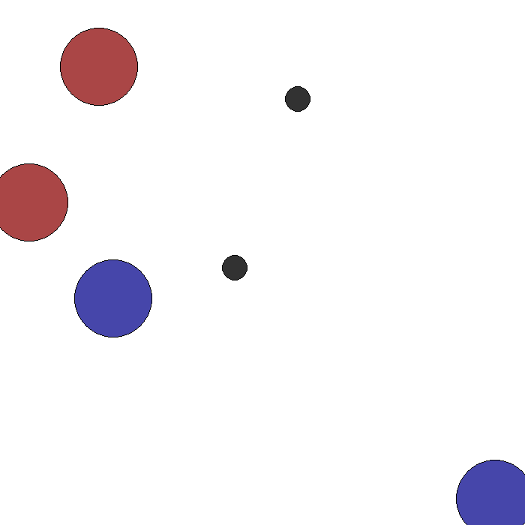
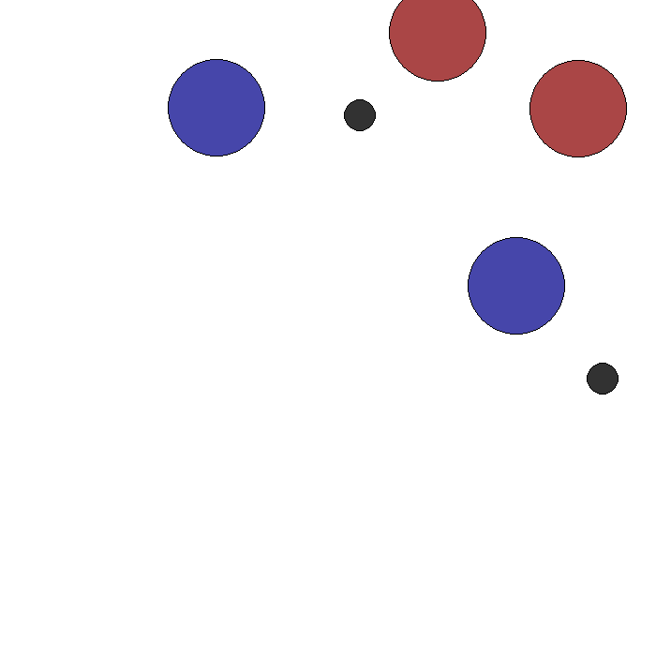
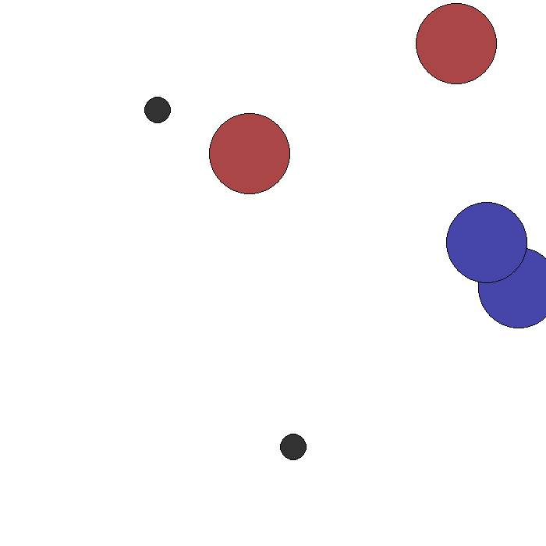
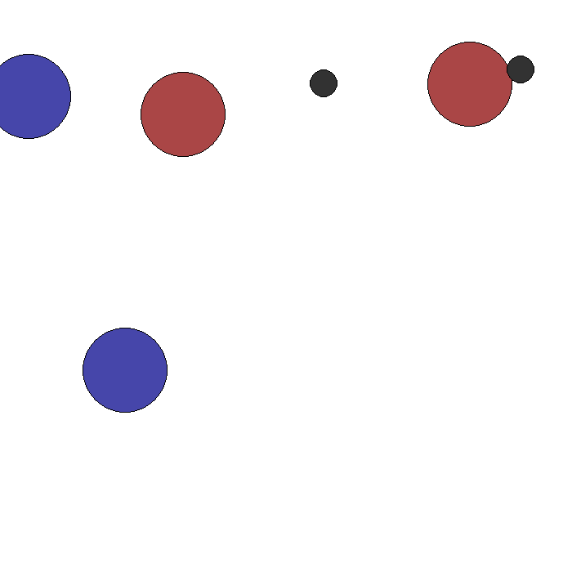
Adversarial Communication Results: 2 adversaries, 2 agents, 2 landmarks, no information transparency
Qualitative results
More obvious signs of cooperation between agents amongst themselves, and vice versa for adversaries
Adversaries seem to underperform compared to the cooperative agents. The cooperative agents are able to reach their goal landmarks most of the time without incurring significant penalties from adversaries
Mode 0
Mode 1
Mode 2
Mode 3
Mode 4
Mode 5
Notes:
Miranda:
Here, now that information is not available between competitors, we see more obvious signs of cooperation between agents of the same type. Now that adversaries are not able to receive communication from non-adversaries on their positions, we see more success from non-adversaries in reaching their goal landmarks.
Interestingly, we do not see significant instances of adversaries “sitting” on top of the goal landmarks in this case.

Slide 21
Conclusion: Limitations / Next Steps
As initially expected, communication helps group performance while the introduction of adversarial elements hurt
Difficult to both push towards and quantitatively measure the optimality of gameplay in mixed/adversarial environments
Areas for potential future exploration:
More complex multiagent environments or tasks (e.g., tasks with extremely long step-sequences)
Different algorithms for multiagent cooperative and/or adversarial gameplay
Quantitative methods for measuring optimality of mixed/adversarial gameplay
Notes:
Miranda:
To wrap it up, we’ve gained some notable insights from our experiments.
Mainly, it is difficult to both push towards and quantitatively measure the optimality of gameplay in mixed/adversarial environments
This is in part, related to how DEC_POMDPs don't guarantee convergence to optimal solution b/c the Markov process isn't stable
Despite that, we found at least one case where we think our agents reached a Nash equilibrium (or something close)
In our mixed setting, as expected, more communication generally helps cooperative agents in reaching their goals when adversarial agents do not receive the same communication.
We also found that some amount of communication improves performance, but too much causes gameplay instability, and that communication did not improve performance for larger player games.
When adversarial agents are communicating amongst only themselves, and vice versa for cooperative agents, we see more collaboration among non-adversarial agents in achieving their goals.
Some areas to look for in exploring further are: (read slide)

Slide 22
References:
Our GitHub Page:
The Surprising Effectiveness of PPO in Cooperative Multi-Agent Games: https://arxiv.org/pdf/2103.01955
Reinforcement Learning to Play an Optimal Nash Equilibrium in Team Markov Games: https://proceedings.neurips.cc/paper_files/paper/2002/file/f8e59f4b2fe7c5705bf878bbd494ccdf-Paper.pdf
Proximal Policy Optimization Algorithms (Schulman et al., 2017) https://arxiv.org/abs/1707.06347
Multi-Agent Actor-Critic for Mixed Cooperative-Competitive Environments: https://arxiv.org/pdf/1706.02275
https://github.com/sosier/Multi_Agent_Reinforcement_Learning
Notes:
Miranda

Slide 23
Appendix
Additional Experiments
Notes:
Miranda

Slide 24
Contributions
Sean Osier: Built the adversarial simple spread environment; implemented / adapted DQN algorithm for multi-agent setting; performed adversarial experiments
Emily Ye: Adapted PPO algorithm for multi-agent mixed adversarial gameplay; ran/experimented with different versions of MA-PPO on different simple spread settings
Danny Zhang: Modified DQN algorithm and agent class for communication setting; ran communication experiments across all modes for different numbers of agents
Yutong Zhou: Ran communication experiments across all modes for different numbers of agents; modified agent code for communication in adversarial setting under information transparent/non-transparent settings
All: Worked on presentation
Notes:
Miranda

Slide 25
Communication Experiments
We are examining the effects of different communication modes within the 2 agent, 2 landmark configuration
Other configurations such as 3 agents/3 landmarks, 2 agents/3 landmarks, 2 agents/4 landmarks, and 4 agents/4 landmarks have been omitted from the results due to a high degree of similarity to the 2 agent/2 landmark game
The rewards between agents are homogeneous for our cooperative experiments; the charts for only one agent from each experiment are shown
Notes:
Danny

Slide 26
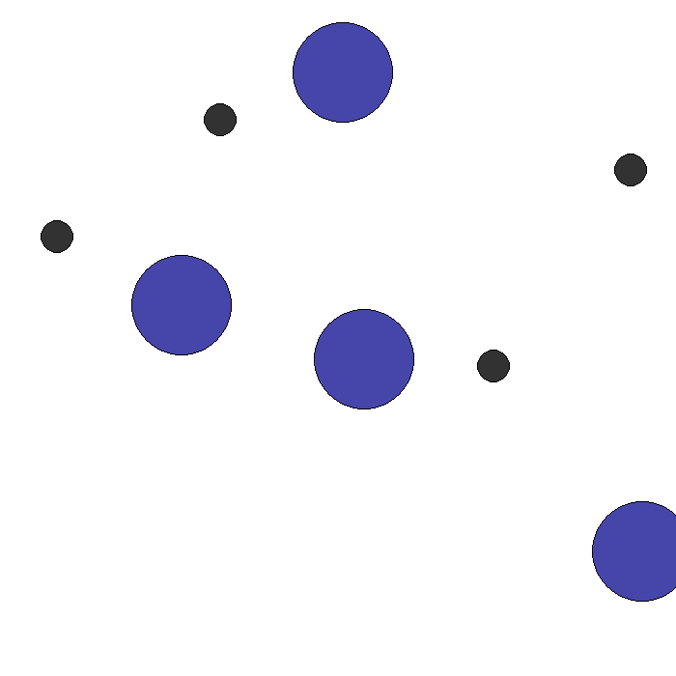
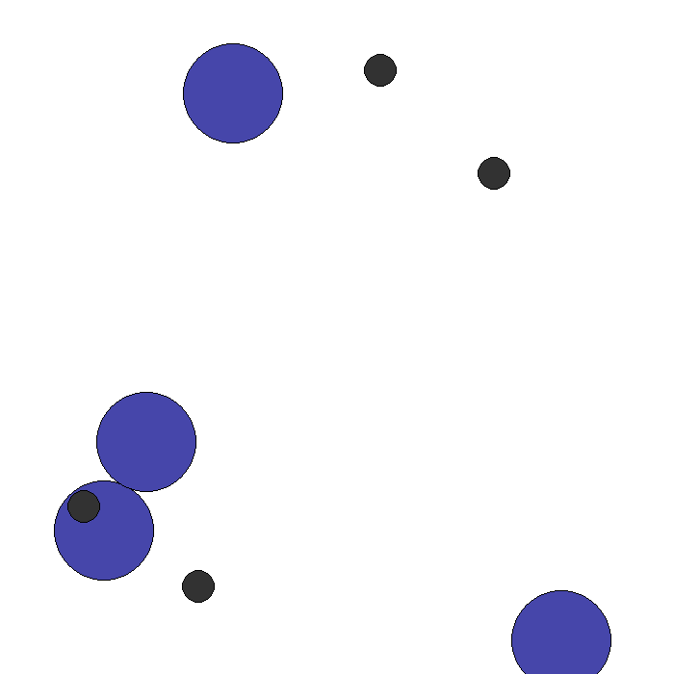
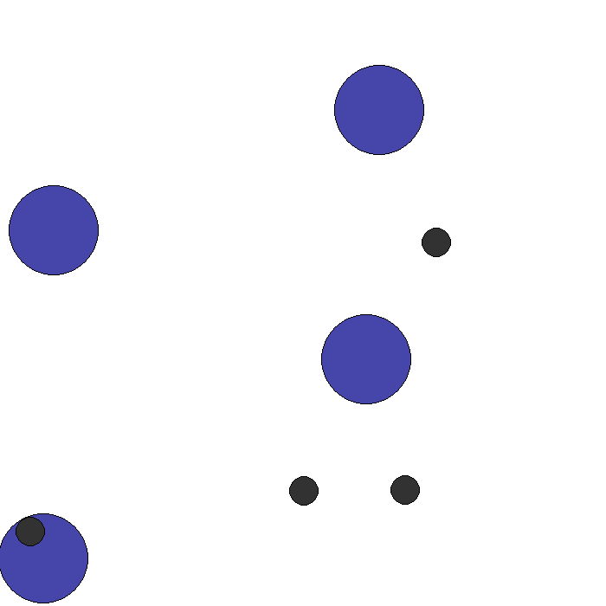
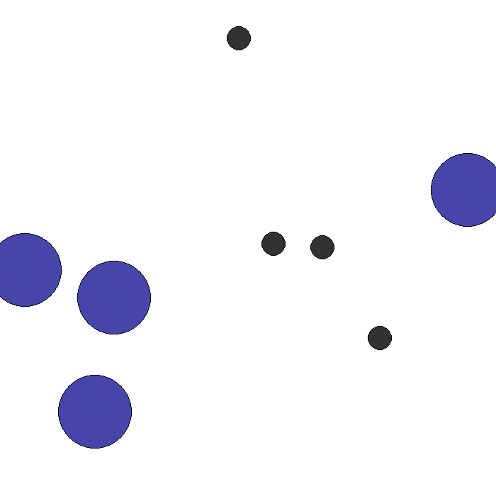
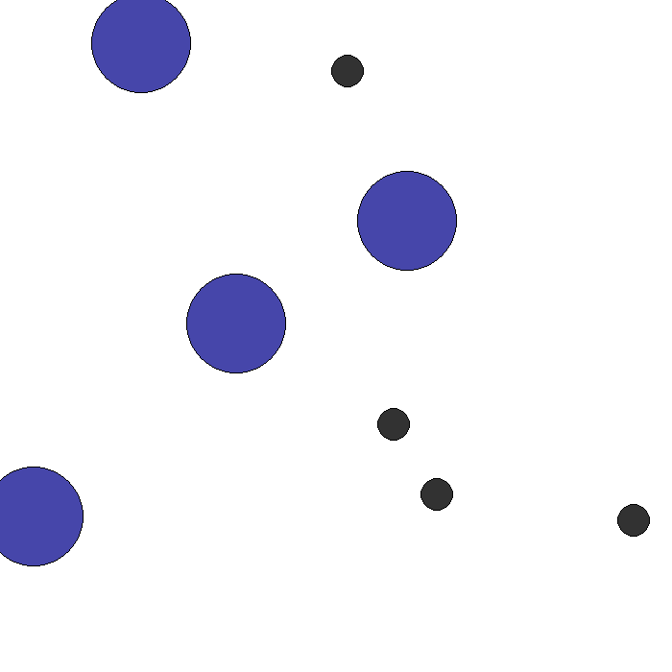
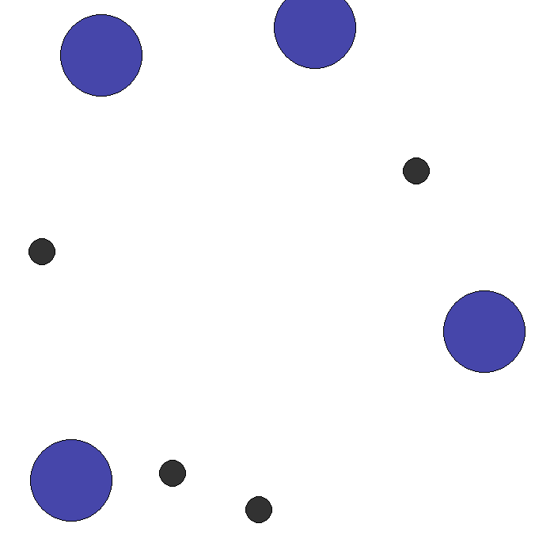
Communication Results: 4 agents, 4 landmarks
Qualitative results
Using 4 agents and 4 landmarks as the configuration yields relatively poor performance with no communication enabled
Unlike in 2 agent 2 landmark configuration, adding additional communication to this configuration does not meaningfully increase quality of gameplay
Mode 0
Mode 1
Mode 2
Mode 3
Mode 4
Mode 5
Notes:
Danny

Slide 27
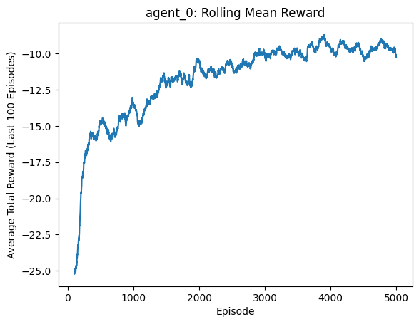
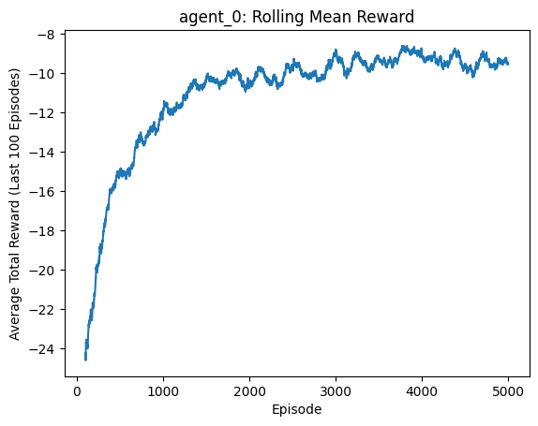
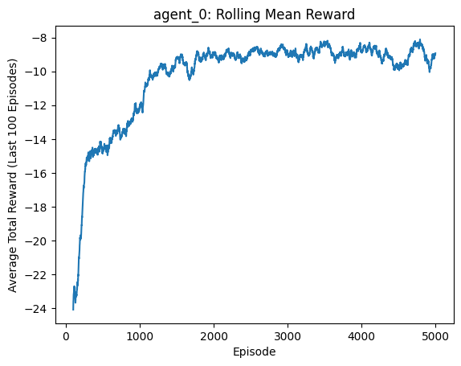
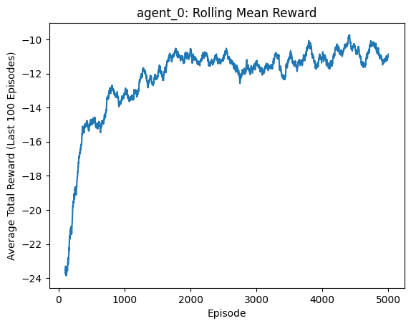
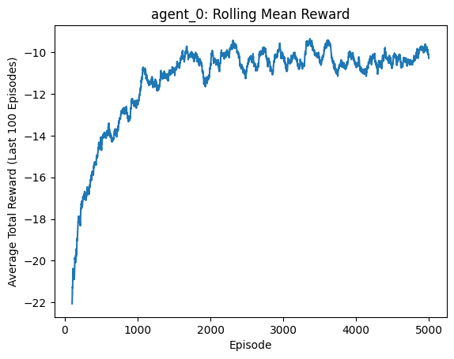
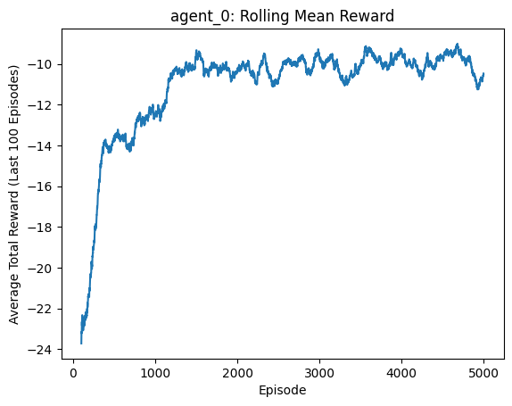
Communication Results: 2 agents, 2 landmarks(2/3)
Mode 0
Mode 1
Mode 2
Mode 3
Mode 4
Mode 5
Notes:
Danny

Slide 28
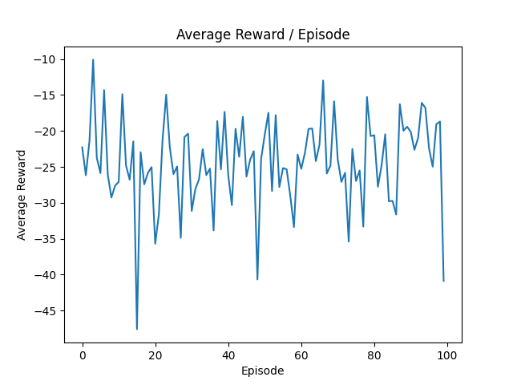
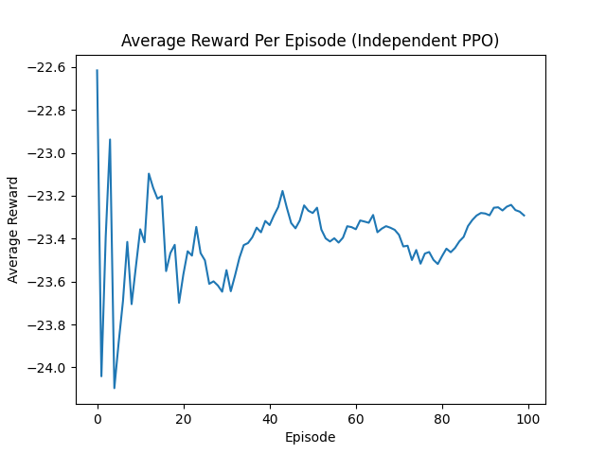
Example: 2 adv., 4 agents, 4 landmarks
DQN
PPO

Slide 29






Communication Results: 2 agents, 3 landmarks
Qualitative results
Mode 1, where the agents receive communication on other agents’ positions, allows the agents to coordinate their respective goal landmarks, so they do not seek the same ones
Mode 3 (Euclidean distance from landmarks) yielded results where one agents was unable to reach the goal landmark
Mode 5 (velocities and Euclidean distances) yielded results where both agents failed to reach goal landmarks
Mode 0
Mode 1
Mode 2
Mode 3
Mode 4
Mode 5

Slide 30



Communication Results: 2 agents, 3 landmarks
Decreased rolling mean rewards when compared to 2 agents, 2 landmarks:
Similar rolling mean reward changes between communication modes
3 landmarks: Mode 0
3 landmarks: Mode 1
3 landmarks: Mode 2

Slide 31



Communication Results: 2 agents, 3 landmarks
Benefits of increased communication more evident with increased number of landmarks
3 landmarks: Mode 3
3 landmarks: Mode 4
3 landmarks: Mode 5

Slide 32






Communication Results: 4 agents, 4 landmarks
Mode 0
Mode 1
Mode 2
Mode 3
Mode 4
Mode 5

Slide 33






Adversarial Communication Results: 1 adversary, 2 agents, 2 landmarks, information transparency
Mode 0
Mode 1
Mode 2
Mode 3
Mode 4
Mode 5

Slide 34


Communication Results: 1 adversary, 2 agents, 2 landmarks, information transparent
Mode 0
Mode 1

Slide 35


Communication Results: 1 adversary, 2 agents, 2 landmarks, information transparent
Mode 2
Mode 3

Slide 36


Communication Results: 1 adversary, 2 agents, 2 landmarks, information transparent
Mode 4
Mode 5

Slide 37


Communication Results: 2 adversaries, 2 agents, 2 landmarks, information transparency
Mode 0
Mode 1

Slide 38


Communication Results: 2 adversaries, 2 agents, 2 landmarks, information transparency
Mode 2
Mode 3

Slide 39


Communication Results: 2 adversaries, 2 agents, 2 landmarks, information transparency
Mode 4
Mode 5

Slide 40


Communication Results: 2 adversaries, 2 agents, 2 landmarks, no information transparency
Mode 0
Mode 1

Slide 41


Communication Results: 2 adversaries, 2 agents, 2 landmarks, no information transparency
Mode 2
Mode 3

Slide 42


Communication Results: 2 adversaries, 2 agents, 2 landmarks, no information transparency
Mode 4
Mode 5

